Slide 1


Modeling Solar-Microgrid-EV System in GAMS
26th June 2022
Presented by:
Dr. Muhammad Nurariffudin
Universiti Teknologi Malaysia (UTM)

Slide 2
Objectives of this workshop
To learn about solar PV system, energy storage, electric vehicle, microgrid
To learn about the functionally of Microgrid Optimization Tool for modeling Solar-Microgrid-EV systems
To learn how to use Microgrid Optimization Tool, handling its database in GAMS, and interpreting the results
To apply the developed mathematical models for the evaluation of solar energy case studies related to planning/scheduling problems.

Slide 3

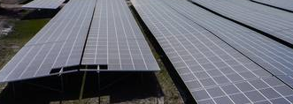
Solar Energy
What is Solar Energy?
Solar energy is radiant light and heat from the Sun that is harnessed using a range of ever-evolving technologies.
Technology | Solar Photovoltaic | Solar Thermal
Function | Convert solar radiation into electricity | Harness heat from the sun for thermal application
Usage | Electricity is widely used | Space heating, hot water, etc.
Efficiency | Up to approximately 20% | Up to 75%

Slide 4
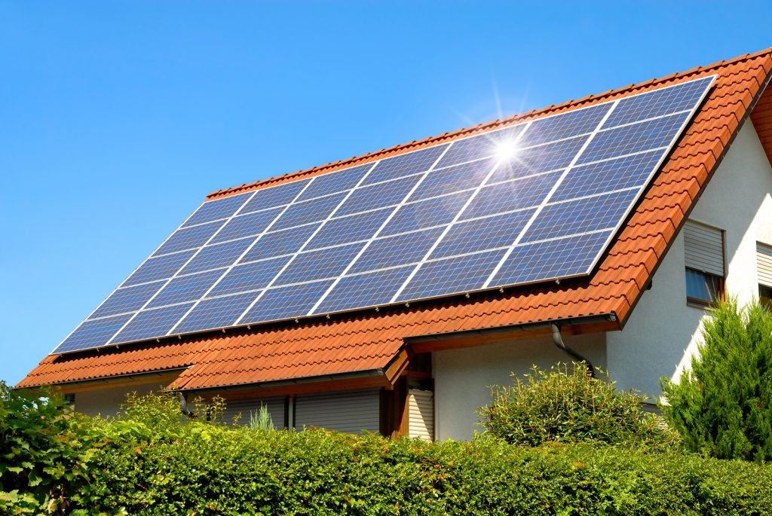
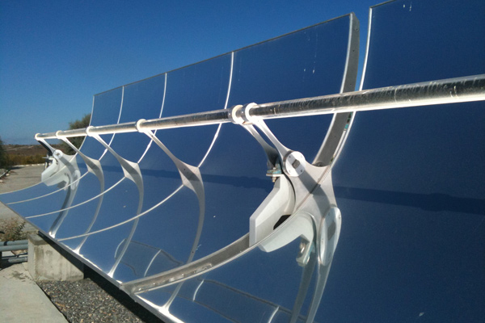
Take a Guess

Slide 5
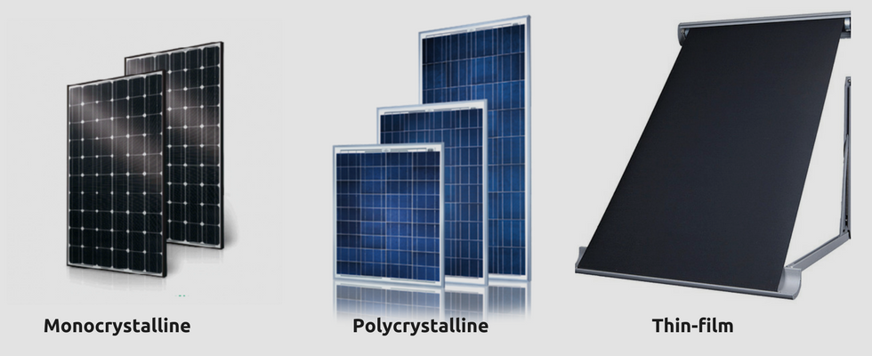
Solar Photovoltaic

Slide 6






Solar PV Components
Inverter
Wiring
Batteries
Charge controller
Disconnect switches
Electrical meter
Converts DC power from solar array to AC for use in your home
Connects the system components
Used to store solar-produced electricity for nighttime or emergency use
Mainly used for remote sites that aren’t tied into the electrical grid
Prevents batteries from being over charged
Allows power from a PV system to be turned off
Measures electrical production and use
Often runs backward if system is attached to the electrical grid

Slide 7
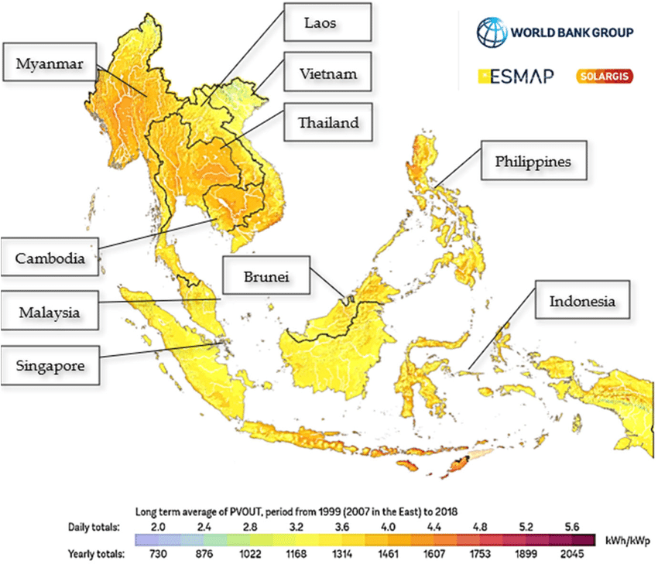
Solar Radiation
Solar photovoltaic (PV) generation has great potential and has been the most attractive renewable energy source amongst the Southeast Asian nations. Annual solar radiation levels in the region ranges from 1,460 to 1,900 kWh/m2/per year.

Slide 8
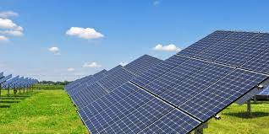
Solar PV Capacity
Kilowatt peak – kWp
kWp is the peak power of a PV system or panel.
When the solar PV panels are operating, they will, over an hour convert the sun’s radiance into electrical energy, which is measured in kilowatt hours (kWh).
PV panels with a peak power of 270 kWp which are working at its maximum capacity for one hour will produce 270kWh.

Slide 9
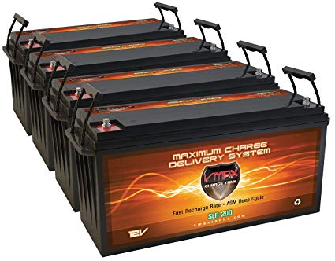
Battery
Used to store solar energy during the day and supply energy at night with sunlight is absent
Not compulsory for grid connected system
Battery can leads to lower system efficiency due to losses during charging and discharging
Battery is expensive
Example of batteries are such as lithium ion, sodium sulphate, etc.

Slide 10
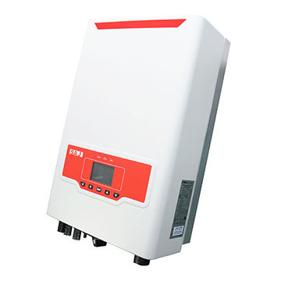
Inverter
Solar PV produces direct current (DC)
Our electronic devices uses alternating current (AC)
Inverter converts DC to AC so that we can utilize the electricity that is generated using solar PV
Our grid network also operate in AC and hence requires solar PV generated electricity to be converted from DC to AC as well

Slide 11
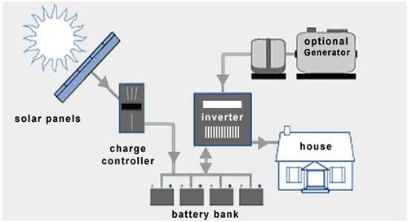
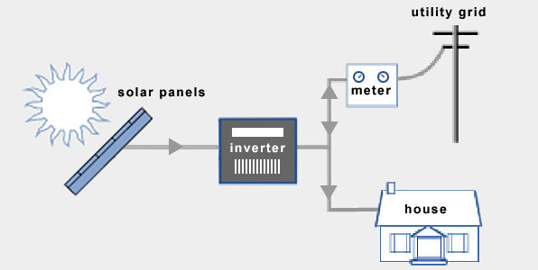
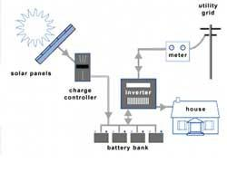
Solar PV Configuration
A) Stand-Alone B) Inject to Grid Hybrid of (A) and (B)
- Directly Sold to the Grid after Use in household
- Household can also purchase electricity from the grid
Can directly be sold to the grid without supplying to the house
Do not require battery
Advantage: Low Cost of Investment, Able to generate revenue
Disadvantage: Must be grid connected and obtain approval to inject electricity
- Stand Alone System
- Electricity have to be from the solar panel or the optional generator (as back up)
- Battery is compulsory to store solar energy during the day time to use at night
Advantage: Self Sustaining, Suitable for off-grid system
Disadvantage: High Cost of Investment due to battery system

Slide 12
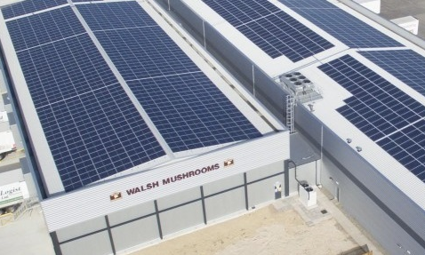
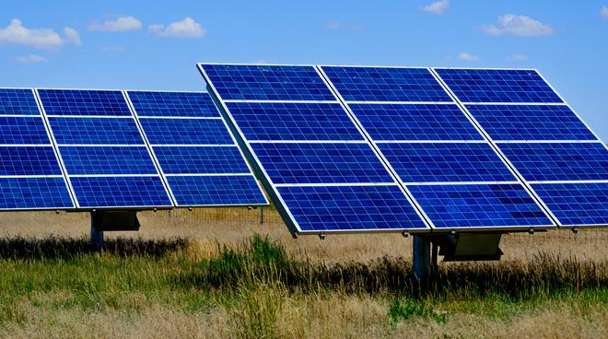
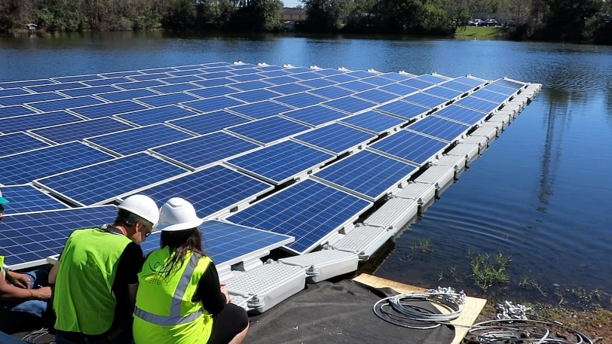
Where to Install Solar PV
A) On Roof B) On Ground C) On Water
Solar PV can be installed on almost any roofs
This proof to be an efficient way to implement solar PV as it utilized unused area
However not all roof can be easily accessed for maintenance
Not all roof are suitable for mount installation
Solar PV can be installed on ground
This allow easier maintenance
Increase project cost due to land acquisition
Waste of valuable land area
Solar PV can be installed floating on water
May interrupt aquatic eco-system
Higher installation cost

Slide 13
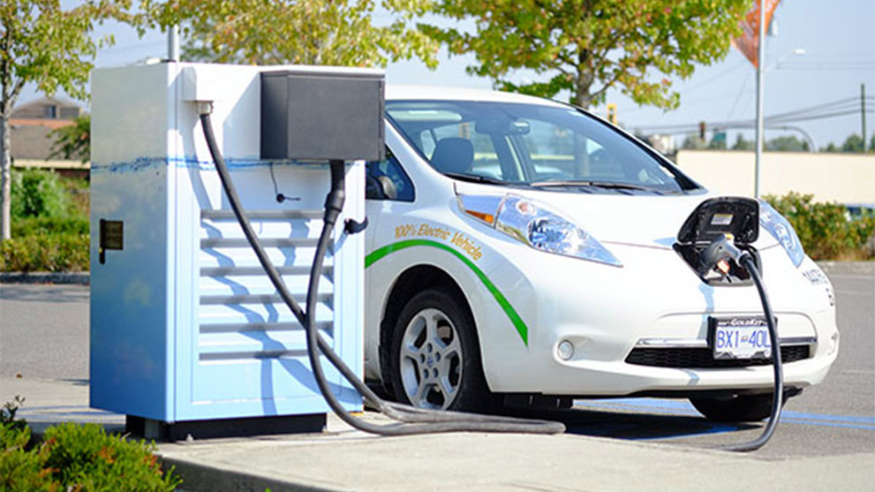
Electric Vehicle
What is Electric Vehicle?
Vehicles with two or more wheels which main powertrain comprises of one or more electric traction motors powered using energy stored in batteries. Requires charging of the batteries from external electric power supply through a vehicle inlet socket.
Includes:
-Battery electric vehicles (BEVs)
-Plug-in hybrid electric vehicles (PHEVs)
Excludes:
-Mild hybrid vehicles
-Full hybrid vehicles

Slide 14
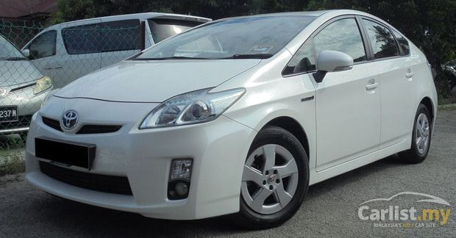
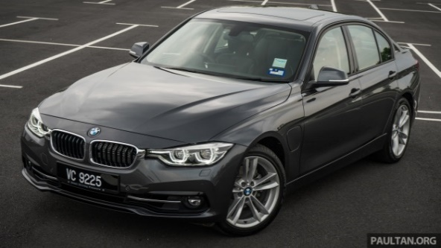
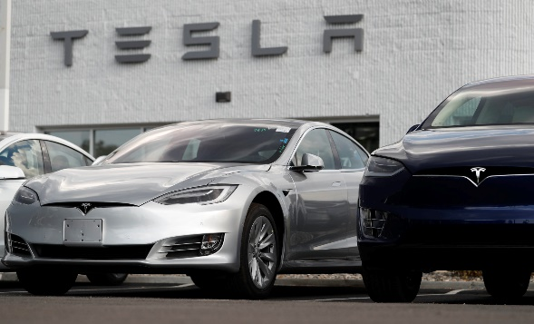

Bigger Engines
Bigger Battery
Internal Combustion Engines
(ICEs)
Hybrid Electric Vehicles (HEVs)
Plug in Hybrid Vehicles (PHEVs)
Electric Vehicle (EV)

Slide 15
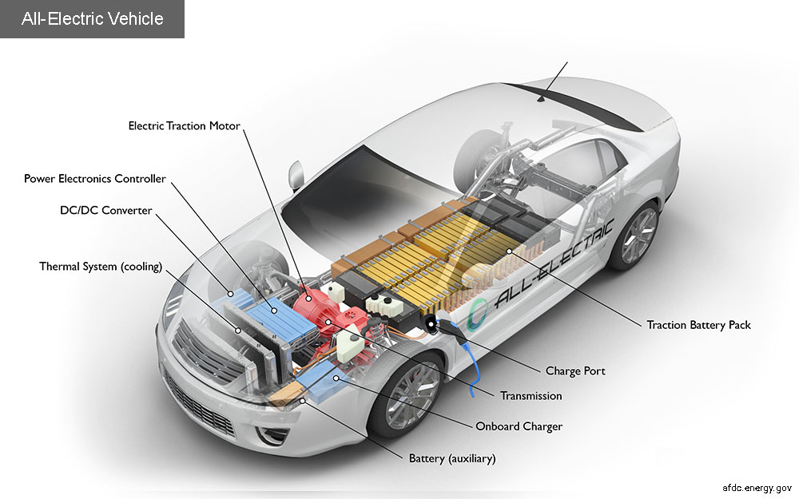

Slide 16
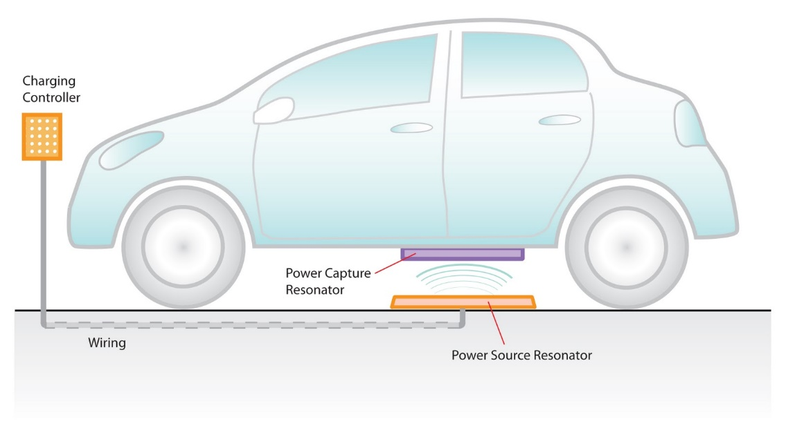
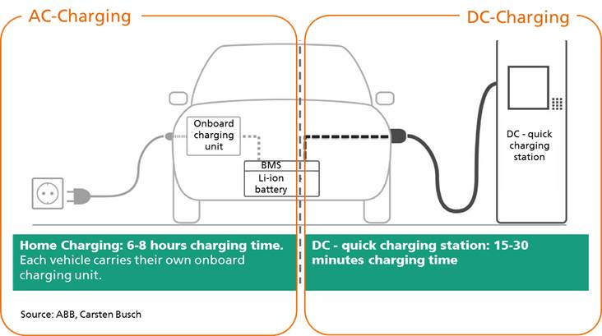
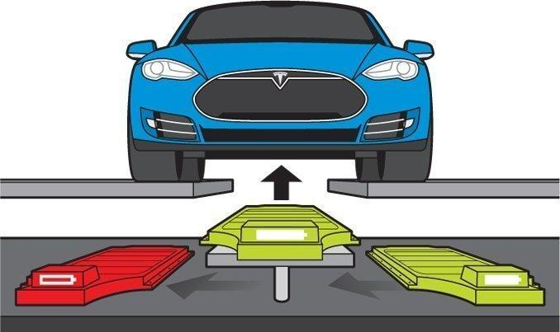
EV Charging
Several methods of charging which are
conductive charging, inductive charging and by battery swapping.

Slide 17
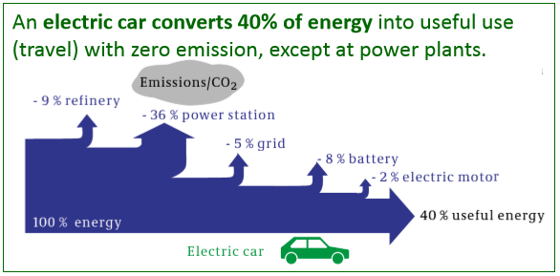
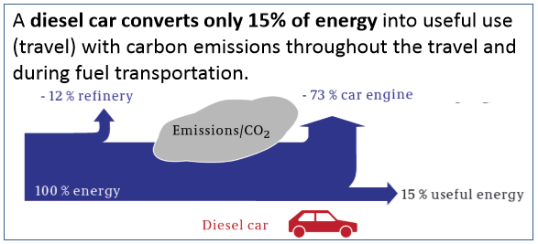
Energy Efficient With a barrel of oil equivalent:
An EV can travel further distance up to 4,021 km
A petrol car can travel only up to 2,199 km
Zero Emission
Even if the electricity is from fossil fuel, it contribute lesser to carbon footprint
And produces no pollution (reduced noise pollution as well) on road
Low Maintenance
Due to lesser working fluids
And lesser moving parts in the vehicles
But it is:
More expensive
More frequent recharging
Long Charging

Slide 18
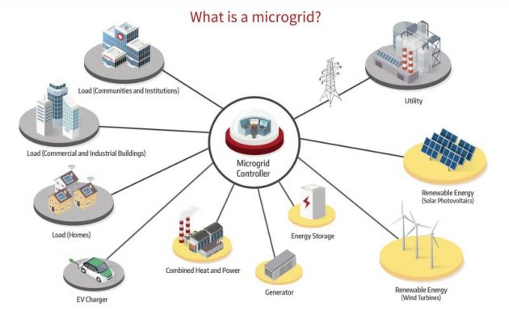
A microgrid is a decentralized group of electricity sources and loads that normally operates, connected to and synchronous with the traditional wide area synchronous grid (macrogrid)
But is able to disconnect from the interconnected grid and to function autonomously in "island mode“
https://microgridknowledge.com/microgrid-defined/#:~:text=A%20microgrid%20is%20a%20self,generators)%20that%20produce%20its%20power.

Slide 19
Microgrid Motivation
Energy Security
Economic Benefits
Infrastructure Cost Savings
There is a growing concern that weather-related disruptions will become more frequent
Microgrids offer several types of efficiency improvements including reduced line losses; combined heat, cooling, and power; and transition to direct current distribution systems to avoid wasteful DC-AC conversions
electrical grids are run near critical capacity
The grid today increasingly relies on advanced information and communications technologies, making it vulnerable to cyberattack
Clean Energy Integration
Important clean energy sources to address climate change like solar PV and wind are variable and non-controllable, which can cause challenges like
- overgeneration
- steep ramping and
- voltage control problems
Microgrids are designed to handle variable generation, using storage technologies to locally balance generation and loads.

Slide 20
So what do we want to know in this study?
Battery can help in load balancing, and EV operates on large battery capacity, can they be used for load balancing?
Having multiple resources of energy, which should be prioritized for utilization and which for storage?
When the charging happen, day or night?
Does additional energy storage system is required?
What about environment impact?
And most importantly what about cost impact?

Slide 21

Recaps of the previous session workshop
We have learned about the concept of optimization and learned on how to use the GAMS software for analysis.
Generally, GAMS utilizes high-level programming language to simplify the coding so that we can write mathematical formulations in the most general way as possible with minimal syntax.
We have also learned that GAMS can be used in a more user friendly manner―utilizing spreadsheet as an interface to input data into GAMS and extracting data from it to spreadsheet.
For the current workshop session, we will learn more about this functionality and focus on the applications (instead of development) of models for different scenarios.
Data Exchange in GAMS using Excel as an interface
Input
Output

Slide 22

Microgrid Optimization Tool
Microgrid Optimization Tool
Objective Function
Minimize${ TotalCost}_{ }={CAPEX}_{VRE}+{CAPEX}_{BatteryEnergy}+{CAPEX}_{BatteryPower}+{CAPEX}_{inverter}+{CAPEX}_{EV}+{CAPEX}_{EVBattery}+ {OPEX}_{VRE}+{OPEX}_{Battery}+{OPEX}_{EVMaintenance}+{Cost}_{GridElectricity}−{Revenue}_{V2G}$
Energy-related dataset:
Maximum area for VRE deployment
Hourly irradiance/capacity factor
Hourly load profiles
VRE efficiency
Storage efficiency
Capacity constraint
Cost-related dataset:
VRE investment cost
VRE operating cost
EV investment cost
EV operating cost
Electricity tariffs
Main Objective
Meeting the hourly electricity demand at the minimal cost
Vehicle-related dataset:
EV battery capacity
EV/V2G Charging efficiency
EV/V2G discharging efficiency
Charging profiles
Consumption profiles
Vehicle travel demand constraint
Key Drivers for VRE penetration:
Decreased VRE costs
Decreased battery costs
Increased time-of-use (TOU) tariff rate
Increased VRE efficiency
Increased in fossil fuel prices

Slide 23
Energy Demand Structure in the Model
Solar Irradiation
Solar PV
Residential Load
Battery Energy Storage
Consumers
Wind
Speed
Wind Turbine
Commercial Load
Consumers
Electricity Load
Grid Electricity
Industrial Load
Consumers
Electric Vehicle
Constraints:
VRE availability constraints (based on a solar irradiation for PV and capacity factor for wind)
Upper bound microgrid area limit
Upper bound inverter capacity constraint
Upper bound rectifier capacity constraint
Unit VRE size constraints
Constraint:
Electricity demand equality constraints
Consumers
Constraints:
Binary charging occurences, e.g., charging can be done at night for residential and during the day for commercial, industries
Restriction constraint - No charging when discharging, and vice versa
Upper bound battery capacity constraint
Upper bound EV battery capacity constraint
Upper bound V2G capacity constraint
Unit battery size constraints
Travel demand constraints

Slide 24
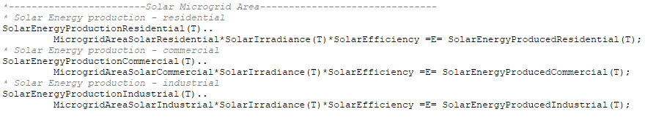
Energy Demand Structure in the Model
Solar Irradiation
Solar PV
Residential Load
Battery Energy Storage
Consumers
Wind
Speed
Wind Turbine
Commercial Load
Consumers
Electricity Load
Grid Electricity
Industrial Load
Consumers
Electric Vehicle
Equality Constraint – Solar Energy Availability

Slide 25
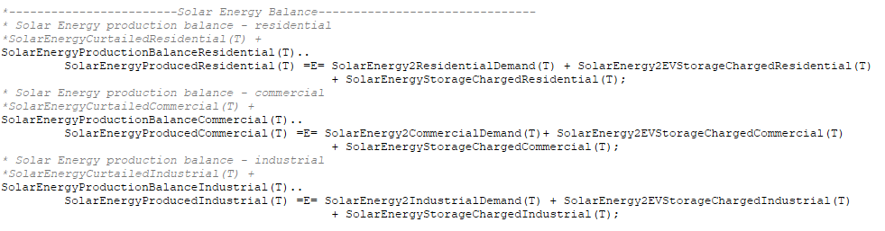
Energy Demand Structure in the Model
Solar Irradiation
Solar PV
Residential Load
Battery Energy Storage
Consumers
Wind
Speed
Wind Turbine
Commercial Load
Consumers
Electricity Load
Grid Electricity
Industrial Load
Consumers
Electric Vehicle
Solar Energy Production Balance

Slide 26
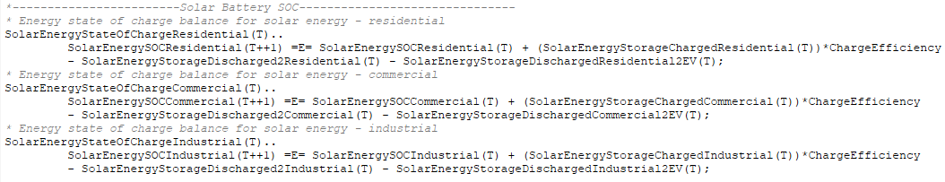
Energy Demand Structure in the Model
Solar Irradiation
Solar PV
Residential Load
Battery Energy Storage
Consumers
Wind
Speed
Wind Turbine
Commercial Load
Consumers
Electricity Load
Grid Electricity
Industrial Load
Consumers
Electric Vehicle
Battery State-of-Charging Balance

Slide 27
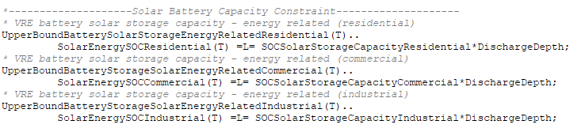
Energy Demand Structure in the Model
Solar Irradiation
Solar PV
Residential Load
Battery Energy Storage
Consumers
Wind
Speed
Wind Turbine
Commercial Load
Consumers
Electricity Load
Grid Electricity
Industrial Load
Consumers
Electric Vehicle
Inequality Constraint – Upper-Bound Battery Capacity

Slide 28
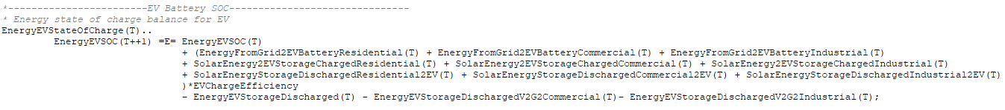
Energy Demand Structure in the Model
Solar Irradiation
Solar PV
Residential Load
Battery Energy Storage
Consumers
Wind
Speed
Wind Turbine
Commercial Load
Consumers
Electricity Load
Grid Electricity
Industrial Load
Consumers
Electric Vehicle
EV Battery State-Of-Charging Balance

Slide 29
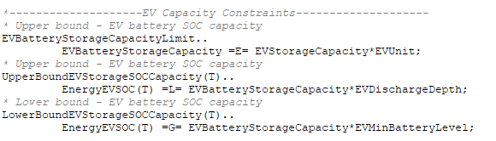
Energy Demand Structure in the Model
Solar Irradiation
Solar PV
Residential Load
Battery Energy Storage
Consumers
Wind
Speed
Wind Turbine
Commercial Load
Consumers
Electricity Load
Grid Electricity
Industrial Load
Consumers
Electric Vehicle
Inequality Constraint - Upper-Bound EV Battery Capacity

Slide 30
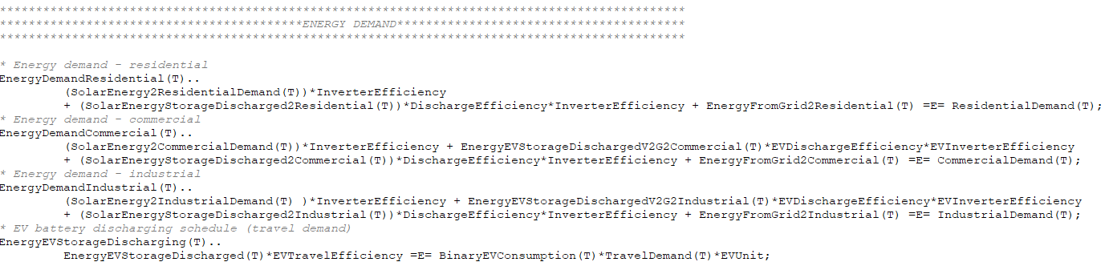
Energy Demand Structure in the Model
Solar Irradiation
Solar PV
Residential Load
Battery Energy Storage
Consumers
Commercial Load
Consumers
Electricity Load
Grid Electricity
Industrial Load
Consumers
Electric Vehicle
Equality Constraint –
Electricity and Travel Demands

Slide 31
Excel Database for GAMS
In order for the model to work, there are three files that are needed in the folder containing your gams file:
Microgrid_Tool.gms – The mathematical formulations coded in GAMS.
Microgrid_INPUT.xlsx – The excel input database where you can change the data for analyzing different scenarios.
Microgrid_OUTPUT.xlsx – The excel output database where you can extract the key results.
When you run the model, there will be the other files that are generated other than those three in the same folder. You don’t have to worry about this as the key results have already been extracted out to Microgrid_Output.xlsx.
Users that are familiar with extracting long list of results in the software window (in lst file or gdx file) can analyze the results in a common way.
If you require to extract specific values from specific variables which are not extracted in Microgrid_Output.xlsx, you need to extract it directly from the GAMS software.
One drawback from this execution approach is that when running the model, users have to close Microgrid_OUTPUT.xlsx to allow GAMS to overwrite the results in this file. This automation will however be improved from time-to-time for a more user-friendly handling.

Slide 32
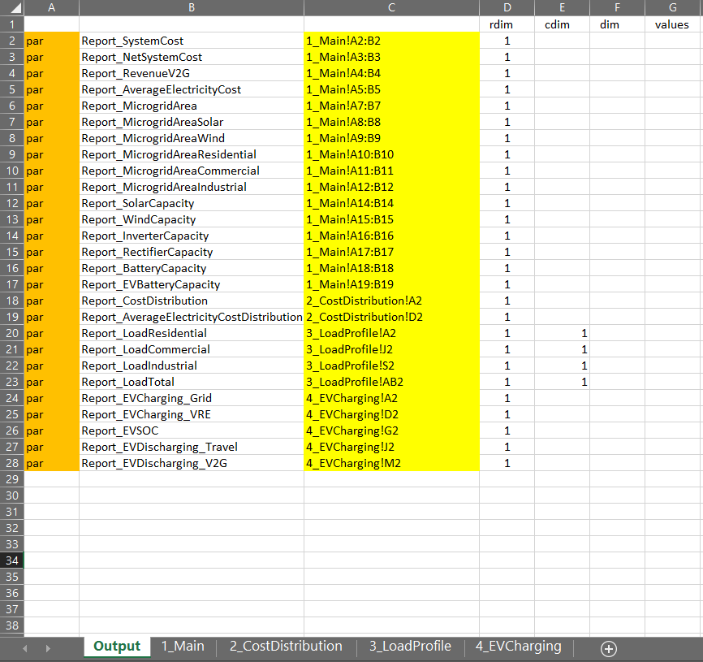
Key Results in Microgrid_OUTPUT.xlsx
On the right-hand side, listed all the key results extracted from the model categorized into four main groups, namely 1_Main, 2_CostDistribution, 3_LoadProfile, 4_EVCharging.

Slide 33
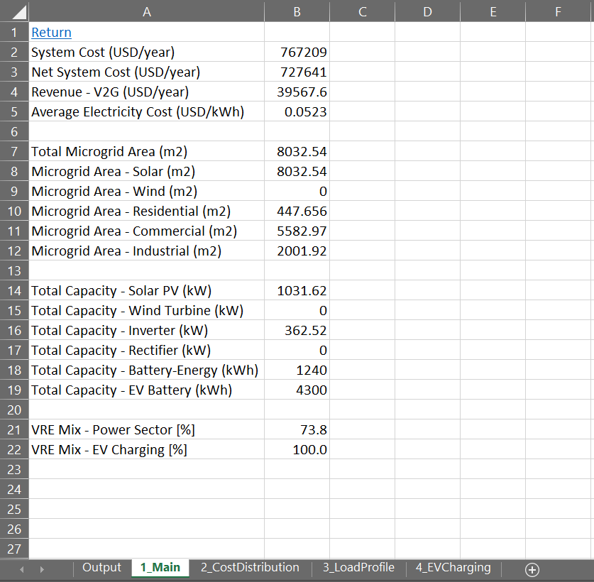
Key Results in Microgrid_OUTPUT.xlsx
On the right-hand side, listed all the key results extracted from the model categorized into four main groups, namely 1_Main, 2_CostDistribution, 3_LoadProfile, 4_EVCharging.
1_Main listed general cost outputs, microgrid areas, microgrid scales, and VRE penetration.

Slide 34
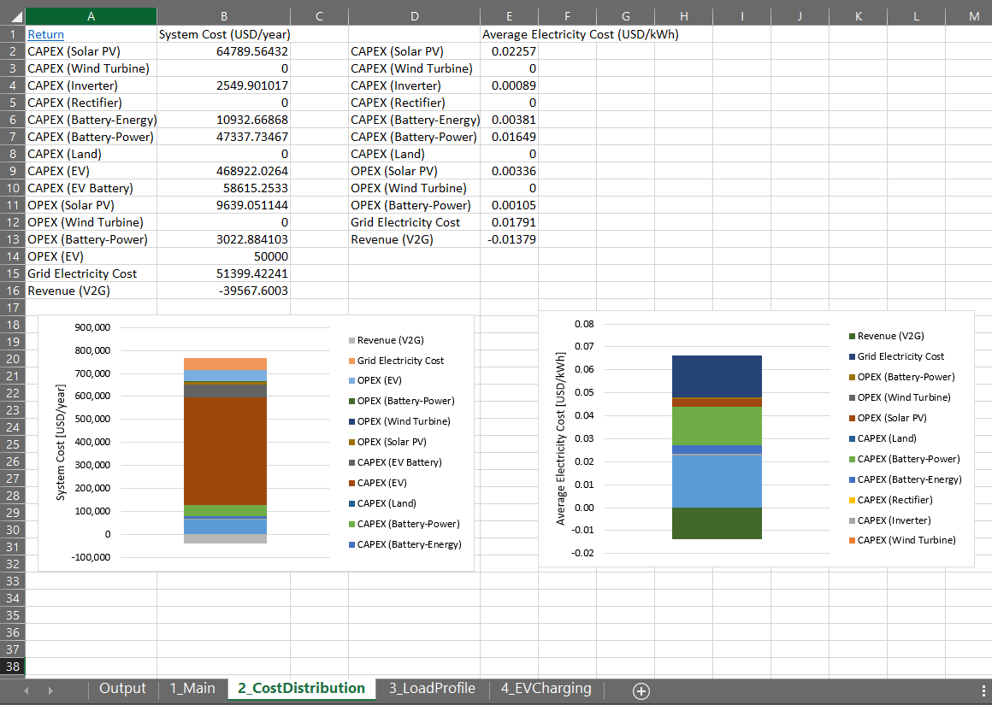
Key Results in Microgrid_OUTPUT.xlsx
On the right-hand side, listed all the key results extracted from the model categorized into four main groups, namely 1_Main, 2_CostDistribution, 3_LoadProfile, 4_EVCharging.
1_Main lists general cost outputs, microgrid areas, microgrid scales, and VRE penetration.
2_CostDistribution lists the distributions of system cost and average electricity cost.

Slide 35
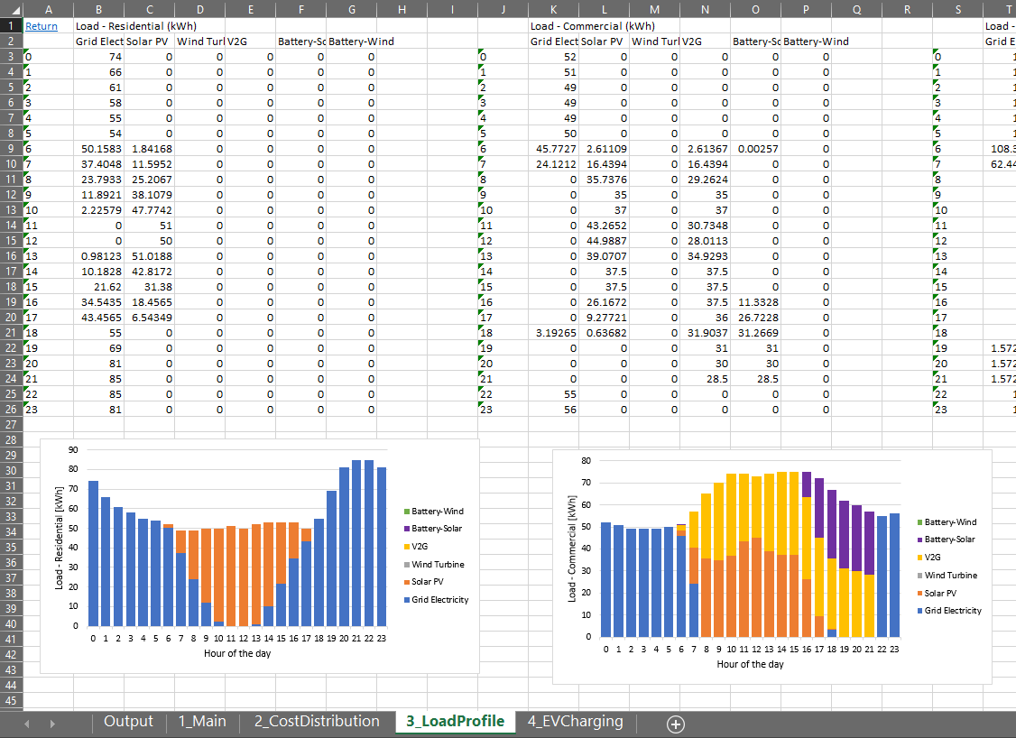
Key Results in Microgrid_OUTPUT.xlsx
On the right-hand side, listed all the key results extracted from the model categorized into four main groups, namely 1_Main, 2_CostDistribution, 3_LoadProfile, 4_EVCharging.
1_Main lists general cost outputs, microgrid areas, microgrid scales, and VRE penetration.
2_CostDistribution lists the distributions of system cost and average electricity cost.
3_LoadProfile lists the distributions of generation types for residential, commercial, industrial, and total electricity demands.

Slide 36
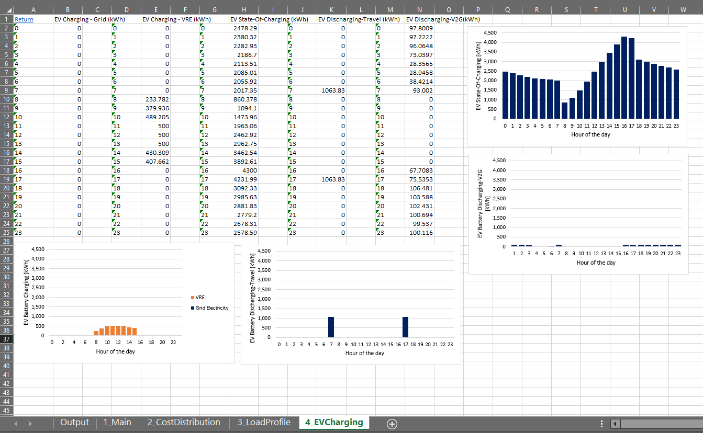
Key Results in Microgrid_OUTPUT.xlsx
On the right-hand side, listed all the key results extracted from the model categorized into four main groups, namely 1_Main, 2_CostDistribution, 3_LoadProfile, 4_EVCharging.
1_Main lists general cost outputs, microgrid areas, microgrid scales, and VRE penetration.
2_CostDistribution lists the distributions of system cost and average electricity cost.
3_LoadProfile lists the distributions of generation types for residential, commercial, industrial, and total electricity demands.
4_EVCharging lists the state-of-charging (SOC), charging, discharging and V2G profiles for electric vehicle.

Slide 37
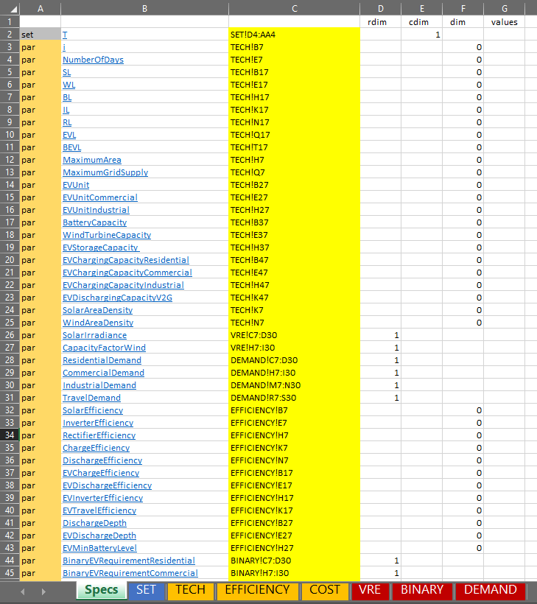
Key Data in Microgrid_INPUT.xlsx
On the right-hand side, listed all the key data as inputs into the model categorized into seven main groups, namely SET, TECH, EFFICIENCY, COST, VRE, BINARY, DEMAND.
In this version of the model, there are 1 SET needed to be declared, namely T which reflects hour of the day, and 67 PARAMETERS needed to be inputted.
Although there are many parameters in the model, only a few of the parameters are essential to be analyzed for their sensitivities.
For example, CAPEX, OPEX, electricity tariff, and efficiencies.
To change the data in Microgrid_INPUT.xlsx, Key in the new data into the selected parameter, click Save and Run the model.

Slide 38
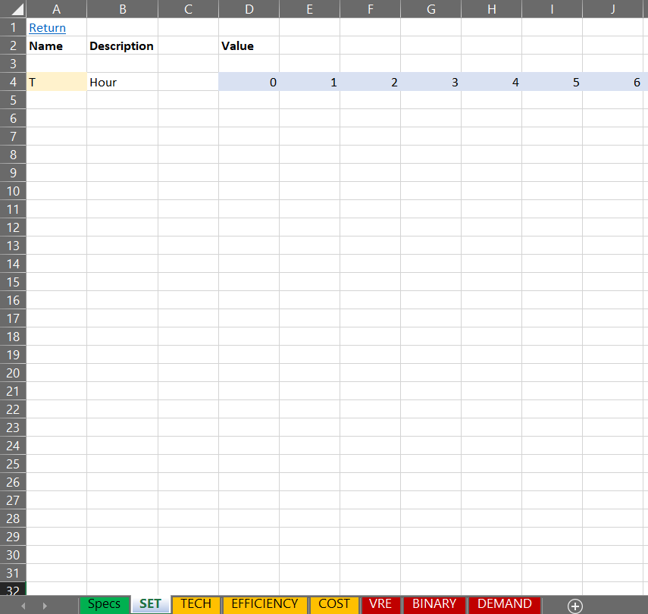
Key Data in Microgrid_INPUT.xlsx
SET lists all the elements corresponding to sets used in the model.

Slide 39
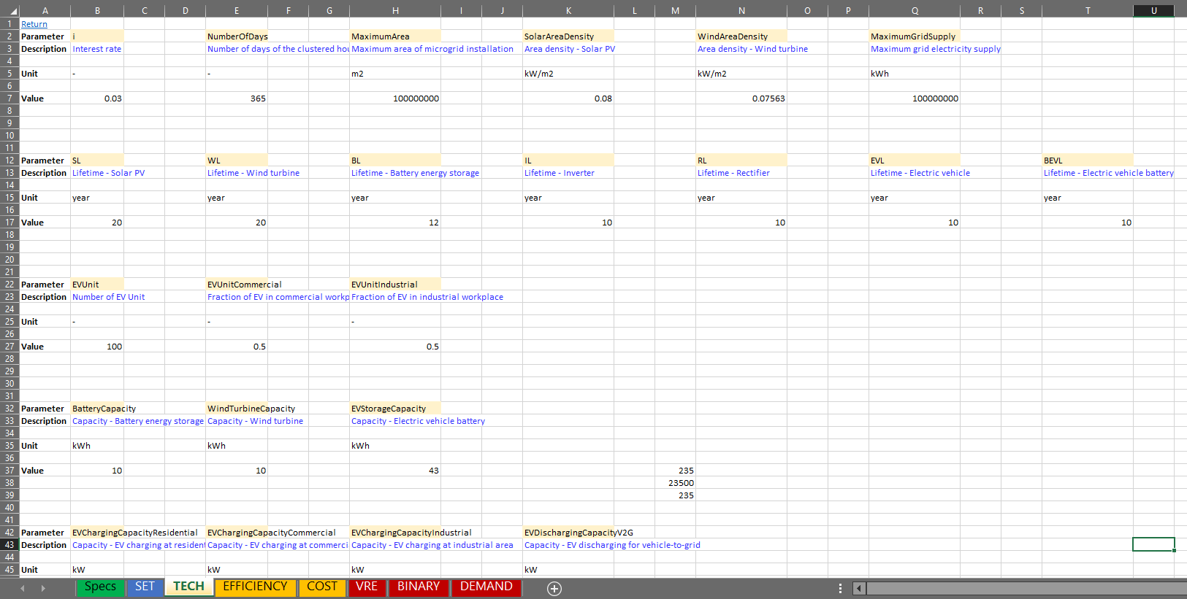
Key Data in Microgrid_INPUT.xlsx
TECH lists all the technical parameters of the VRE, EV, and battery technology, such as power density, lifetime, capacity, number of EV, area limit, and supply limit.

Slide 40
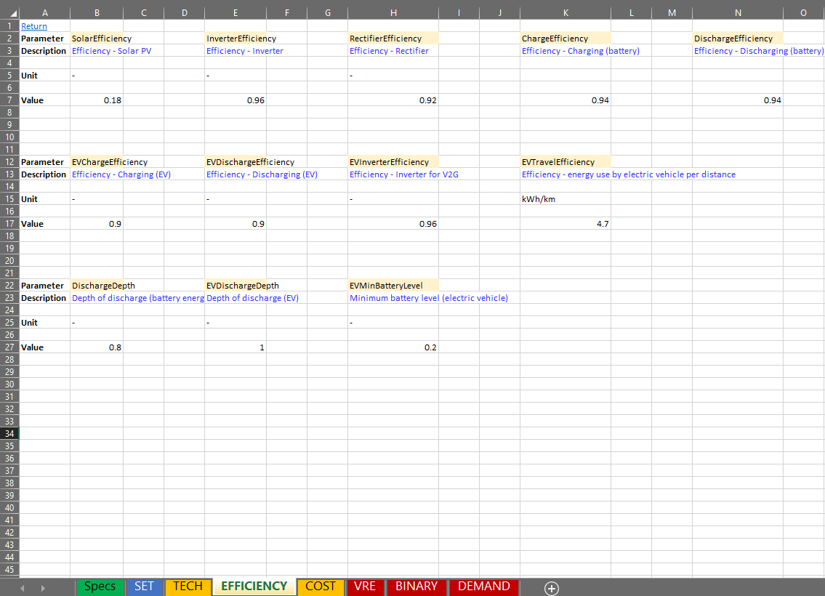
Key Data in Microgrid_INPUT.xlsx
TECH lists all the technical parameters of the VRE, EV, and battery technology, such as power density, lifetime, capacity, number of EV, area limit, and supply limit.
EFFICIENCY lists all the related efficiency and upper/lower limit for VRE, EV, inverter, rectifier, and battery.

Slide 41
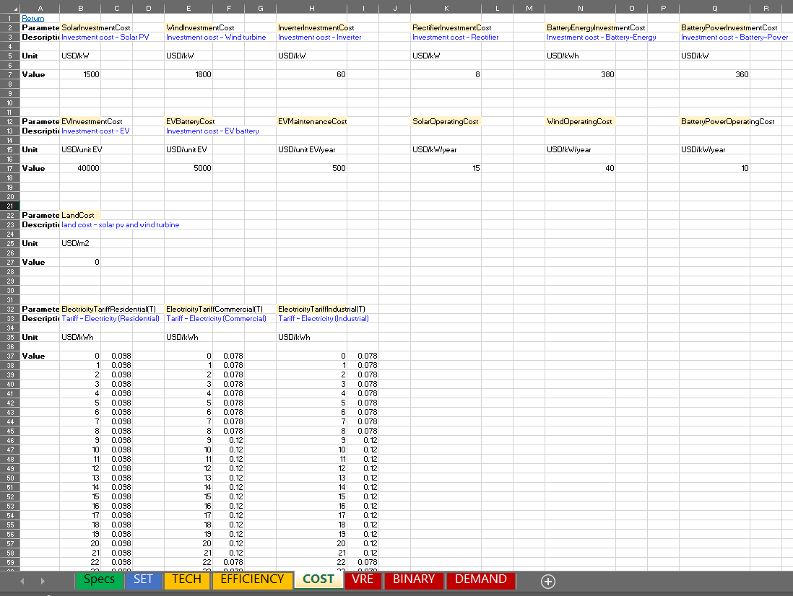
Key Data in Microgrid_INPUT.xlsx
TECH lists all the technical parameters of the VRE, EV, and battery technology, such as power density, lifetime, capacity, number of EV, area limit, and supply limit.
EFFICIENCY lists all the related efficiency and upper/lower limit for VRE, EV, inverter, rectifier, and battery.
COST lists investment costs and operating costs of VRE, EV, inverter, rectifier, and battery, as well as hourly TOU electricity tariffs for residential, commercial, and industrial customers. Note that V2G tariffs follow the tariff used by commercial and industries.

Slide 42
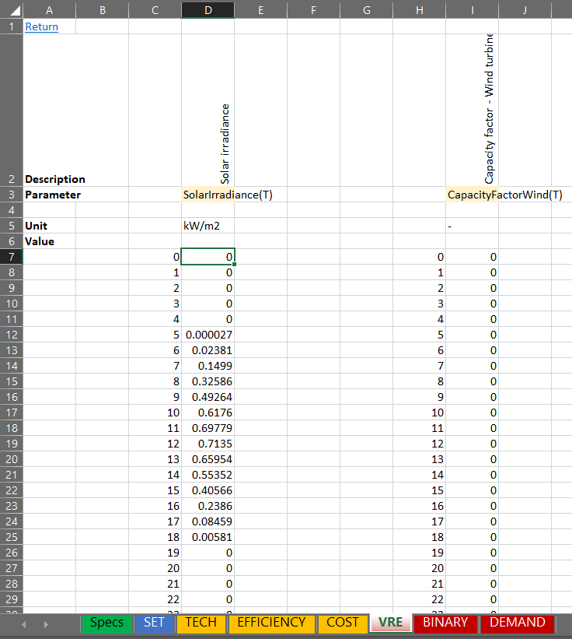
Key Data in Microgrid_INPUT.xlsx
VRE lists the hourly VRE availability parameters such as solar irradiation and capacity factor for wind. Note that capacity factor for wind is left blank, since we are focusing on solar VRE application in this workshop.

Slide 43
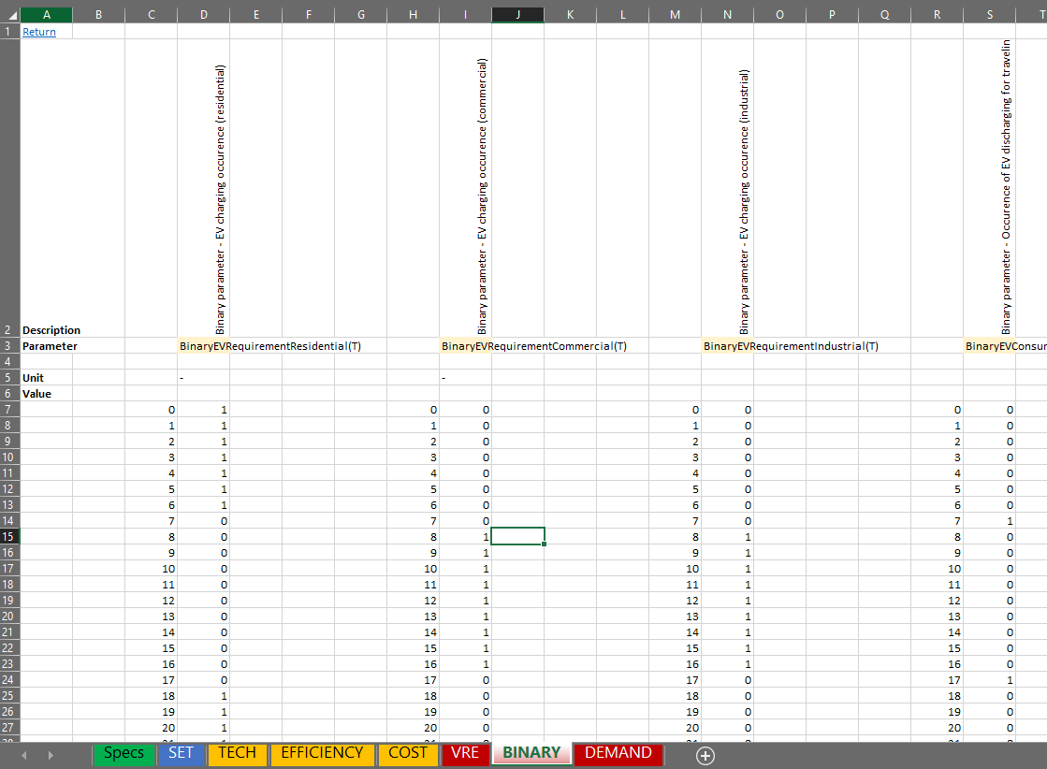
Key Data in Microgrid_INPUT.xlsx
VRE lists the hourly VRE availability parameters such as solar irradiation and capacity factor for wind. Note that capacity factor for wind is left blank, since we are focusing on solar VRE application in this workshop.
BINARY lists the hourly binary parameters reflecting the potential occurrences of activity at each hour, such as EV charging occurrences at residential, commercial and industrial areas, EV travel occurrences during the day, and V2G occurrences.

Slide 44
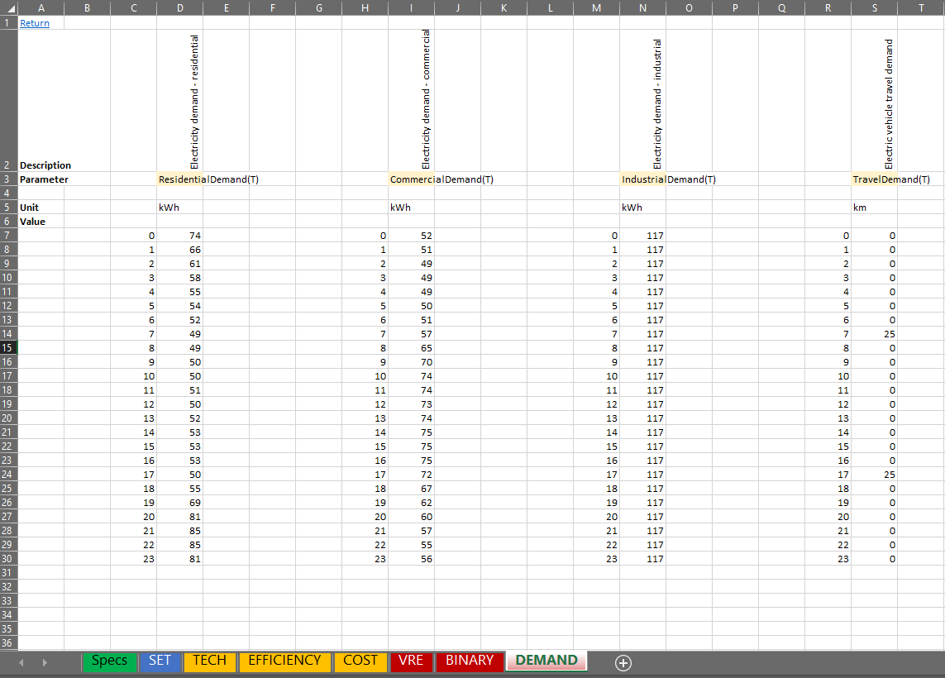
Key Data in Microgrid_INPUT.xlsx
VRE lists the hourly VRE availability parameters such as solar irradiation and capacity factor for wind. Note that capacity factor for wind is left blank, since we are focusing on solar VRE application in this workshop.
BINARY lists the hourly binary parameters reflecting the potential occurrences of activity at each hour, such as EV charging occurrences at residential, commercial and industrial areas, EV travel occurrences during the day, and V2G occurrences.
DEMAND lists the hourly electricity demand for residential, commercial and industrial areas, as well as hourly traveling demand.

Slide 45
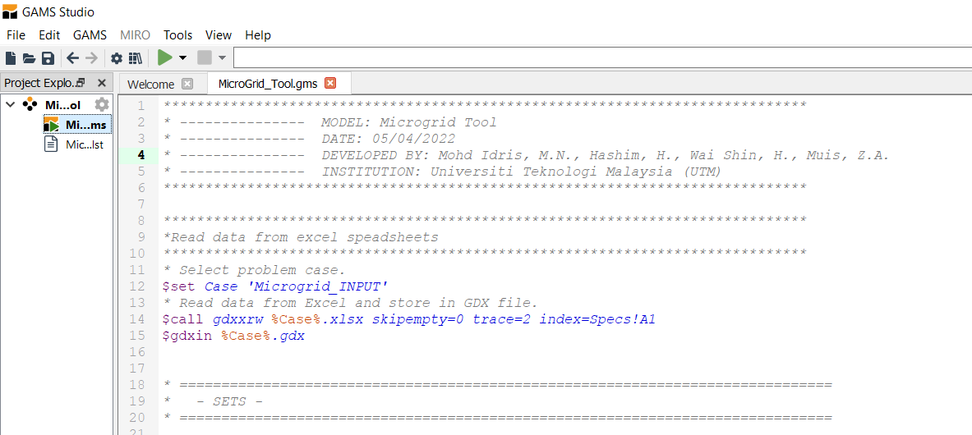
Steps to run the Microgrid Optimization Tool
Step 1: Download Microgrid_Tool.zip, and extract the zipped files into your chosen working folder. You should see that there are three files, namely, Microgrid_Tool.gms, Microgrid_INPUT.xlsx, and Microgrid_OUTPUT.xlsx.
Step 2: Open Microgrid_INPUT.xlsx if you want to change any data.
Step 3: Open Microgrid_Tool.gms in GAMS Studio, click the RUN button.
RUN button

Slide 46
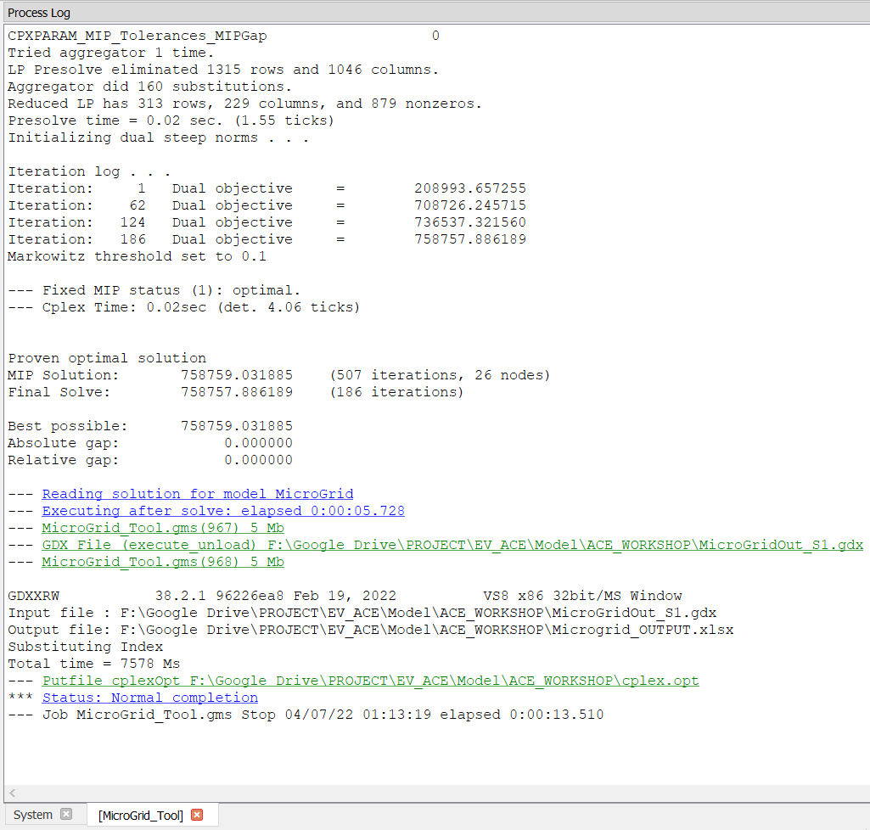
Steps to run the Microgrid Optimization Tool
Step 4: Wait for the model to solve until there appears the completion status. Please note that you need to close Microgrid_OUTPUT.xlsx during the run. Opening Microgrid_INPUT.xlsx while running is fine.
Step 5: Open Microgrid_OUTPUT.xlsx to analyze the results.

Slide 47
Hands-On Session
We will learn how to apply the Microgrid Optimization Tool to analyze a few of scenarios.
Electricity scheduling problems are chosen as the cases to be studied in these exercises:
Meeting electricity demand by grid (To know the reference results).
Meeting electricity demand by grid and solar PV.
Meeting electricity demand + EV by grid and solar PV.
Meeting electricity demand + EV by grid, solar PV, and V2G.
Meeting electricity demand + EV by grid, solar PV, and V2G + Higher V2G Price
Note that the default version of the input data in Microgrid_INPUT.xlsx corresponds to the case 3 above. Thus, for every different cases, users need to change the related data to resemble these cases.

Slide 48
Case Study Overview – Thailand Load Profiles
Solar Irradiation
Load - Residential
Load - Commercial
Load - Industrial
EV Travel Demand
Average hourly solar irradiation in a day is estimated based from the full-hour solar irradiation retrieved from renewables.ninja (2022)
Residential hourly load profiles Thailand (Tongsopit et al., 2019; Chaianong et al., 2020) were adjusted to resemble the load profile for 100 houses. A factor of 14.4 kWh/day of electricity consumption per household retrieved from Murakoshi et al. (2017) were used for the load profile adjustment for Thailand case.
The equivalent daily electricity demand profiles for commercial and industrial workplaces are estimated using the ratio of energy demand between residential, commercial, and industrial types retrieved from Energy Policy and Planning Office Thailand (EPPO, 2022) for Thailand.
Note that constant hourly demand pattern was assumed for industrial electricity loads in reflecting provision of steady-state industrial processes.
The number of EV considered is 100, corresponding to 100 users from 100 houses.
Source: renewables.ninja (2022); Tongsopit et al. (2019); Chaianong et al. (2020); Murakoshi et al. (2017); EPPO (2022).

Slide 49
Case Study Overview – Input Data
Parameter | Value | Unit | Reference
Interest rate | 3 | % | Current estimate
CAPEX (residential solar PV) | 1,500 | USD/kW | SOLS Energy (2021)
CAPEX (inverter) | 60 | USD/kW | Mallapragada et al. (2020)
CAPEX (battery storage power) | 360 | USD/kW | Gupta et al. (2020)
CAPEX (battery storage energy) | 380 | USD/kWh | Gupta et al. (2020)
CAPEX (electric vehicle) | 25,000 | USD/vehicle | Sterchele et al. (2020)
CAPEX (charging station) | 328 | USD/kW | Calvillo and Turner (2020)
OPEX (residential solar PV) | 1% of CAPEX | USD/kW/year | Mallapragada et al. (2020)
OPEX (battery storage) | 10 | USD/kW/year | Gupta et al. (2020)
Maintenance Cost (electric vehicle) | 1% of CAPEX | USD/vehicle/year | Sterchele et al. (2020)
Lifetime (residential solar PV) | 20 | year | Mallapragada et al. (2020)
Lifetime (inverter) | 10 | year | Mallapragada et al. (2020)
Lifetime (battery storage) | 12 | year | Gupta et al. (2020)
Lifetime (electric vehicle) | 10 | year | Sterchele et al. (2020)
Lifetime (charging station) | 25 | year | Calvillo and Turner (2020)
Efficiency (residential solar PV) | 18 | % | Current estimate
Efficiency (inverter) | 96 | % | Mallapragada et al. (2020)
Efficiency (battery charging/discharging) | 94 | % | Gupta et al. (2020)
Efficiency (battery depth-of-discharge) | 80 | % | Assumption
Efficiency (EV charging/discharging) | 90 | % | Assumption
Efficiency (EV battery depth-of-discharge) | 80 | % | Assumption
Efficiency (EV minimum battery level) | 20 | % | Assumption
Efficiency (EV traveling efficiency) | 4.7 | vkm/kWh | Murray et al. (2020)
Capacity (EV battery) | 43 | kW | Murray et al. (2020)
Capacity (EV charging - residential) | 3.3 | kW | ERIA (2018)
Capacity (EV charging – commercial/industrial) | 10 | kW | ERIA (2018)
Capacity (EV discharging - V2G) | 10 | kW | ERIA (2018)
Solar area density | 0.08 | kW/m² | Tröndle et al. (2020)

Slide 50
Case Study Overview – Electricity Tariff
Tariff Classes | Value | Unit | Reference
Based on Thailand’s tariffs (Peak - 9 a.m. to 10 p.m., Off-peak - 10 p.m. to 9 a.m.)
Residential | 0.0980 | USD/kWh | MEA (2022)
Commercial (Peak) | 0.1200 | USD/kWh | MEA (2022)
Commercial (Off-Peak) | 0.0780 | USD/kWh | MEA (2022)
Industrial (Peak) | 0.1200 | USD/kWh | MEA (2022)
Industrial (Off-Peak) | 0.0780 | USD/kWh | MEA (2022)

Slide 51
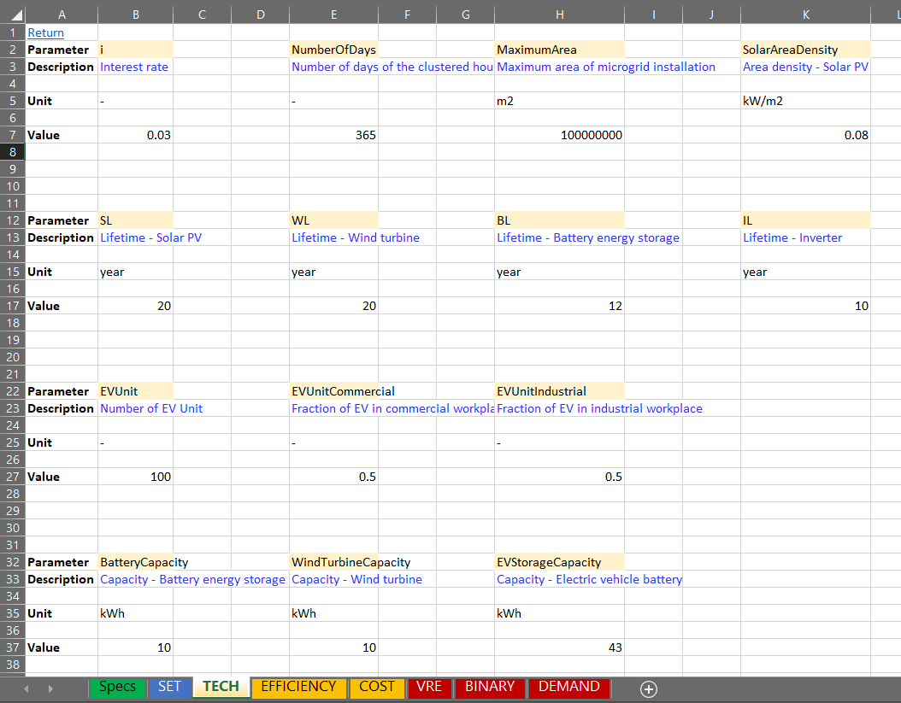
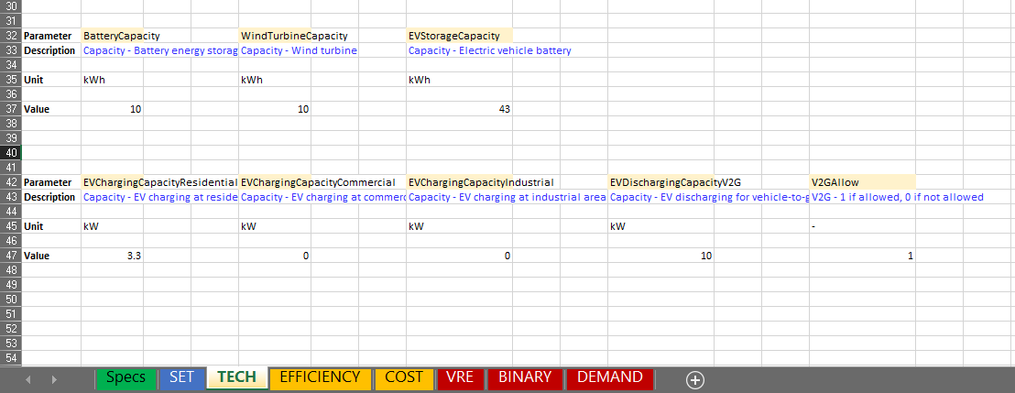
1) Meeting electricity demand by grid
Steps to run this scenario:
Open Microgrid_INPUT.xlsx.
Select TECH tab.
Change the input data highlighted below.
Click Save and Run GAMS
Change this value to 0 to disallow VRE
Change this value to 0 to indicate no EV demand
Change this value to 0 to disallow V2G

Slide 52
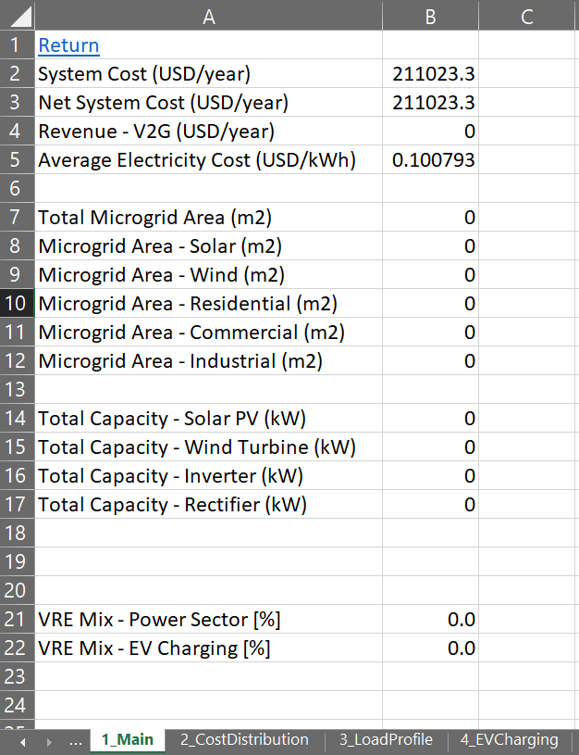
1) Meeting electricity demand by grid
Costs, area, capacity, and VRE Mix

Slide 53

2) Meeting electricity demand by grid and solar PV
Steps to run this scenario:
Open Microgrid_INPUT.xlsx.
Select TECH tab.
Change the input data highlighted below.
Click Save and Run GAMS
Change this value back to a big number to allow VRE, e.g., 1000000

Slide 54
2) Meeting electricity demand by grid and solar PV
Load - Residential
Load - Commercial
Load - Industrial
Load - Total

Slide 55

2) Meeting electricity demand by grid and solar PV
Costs, area, capacity, and VRE Mix
Total System Cost
Average Electricity Cost

Slide 56

3) Meeting electricity demand + EV by grid and solar PV
Steps to run this scenario:
Open Microgrid_INPUT.xlsx.
Select TECH tab.
Change the input data highlighted below.
Click Save and Run GAMS
Change this value back to 100 to indicate EV Units

Slide 57
3) Meeting electricity demand + EV by grid and solar PV
Load - Residential
Load - Commercial
Load - Industrial
Load - Total

Slide 58
3) Meeting electricity demand + EV by grid and solar PV
EV Battery Charging
EV Battery Discharging-Travel
EV Battery State-Of-Charging
EV Battery Discharging-V2G

Slide 59

3) Meeting electricity demand + EV by grid and solar PV
Costs, area, capacity, and VRE Mix
Total System Cost
Average Electricity Cost

Slide 60

4) Meeting electricity demand + EV by grid, solar PV and V2G
Steps to run this scenario:
Open Microgrid_INPUT.xlsx.
Select TECH tab.
Change the input data highlighted below.
Click Save and Run GAMS
Change this value back to 1 to allow V2G

Slide 61
4) Meeting electricity demand + EV by grid, solar PV and V2G
Load - Residential
Load - Commercial
Load - Industrial
Load - Total

Slide 62
4) Meeting electricity demand + EV by grid, solar PV and V2G
EV Battery Charging
EV Battery Discharging-Travel
EV Battery State-Of-Charging
EV Battery Discharging-V2G

Slide 63

4) Meeting electricity demand + EV by grid, solar PV and V2G
Costs, area, capacity, and VRE Mix
Total System Cost
Average Electricity Cost

Slide 64

5) Meeting electricity demand + EV by grid, solar PV and V2G + Higher V2G Price
Steps to run this scenario:
Open Microgrid_INPUT.xlsx.
Select COST tab.
Change the input data highlighted below.
Click Save and Run GAMS
Change this value to 0.2 to indicate higher V2G price

Slide 65
5) Meeting electricity demand + EV by grid, solar PV and V2G + Higher V2G Price
Load - Residential
Load - Commercial
Load - Industrial
Load - Total

Slide 66
5) Meeting electricity demand + EV by grid, solar PV and V2G + Higher V2G Price
EV Battery Charging
EV Battery Discharging-Travel
EV Battery State-Of-Charging
EV Battery Discharging-V2G

Slide 67

5) Meeting electricity demand + EV by grid, solar PV and V2G + Higher V2G Price
Costs, area, capacity, and VRE Mix
Total System Cost
Average Electricity Cost

